Slide 1
STATİSTİCS FOR DATA SCİENCE
DS-11-22- Ladies in Data
TeamWork
26 April 2022

Slide 2
Statistics and Probability Concepts for Data Science
(https://www.analyticsvidhya.com/blog/2021/04/statistics-and-probability-concepts-for-data-science/)
What is Data?
Types of Data
Statistics
Probability

Slide 3
Statistics and Probability Concepts for Data Science

Slide 4
What is Data?
Data is the information collected through different sources which can be qualitative or quantitative in nature.
Mostly, the data collected is used to analyze and draw insights on a particular topic.
For example:
1. Cylinder size, mileage, color, etc. for the sale of a car
2. If the cells in the body are malignant or benign to detect Cancer

Slide 5
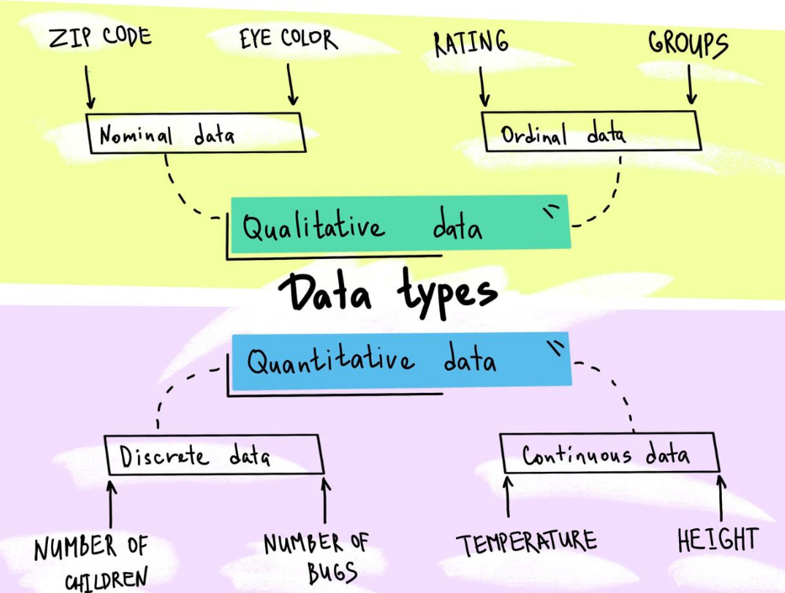
Types of Data

Slide 6
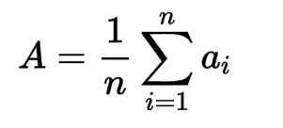
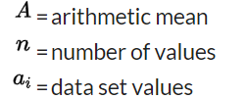
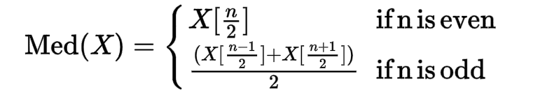
Statistics
Mean
Median
Mode
5,2,6,5,1,1,2,5,3,8,5,9,5 are the set of data points. Here 5 is the mode because it’s occurring most frequently.

Slide 7
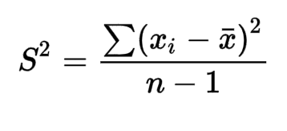
Statistics
Variance :Mathematically and statistically, variance is defined as the average of the squared differences from the mean. But for understanding, this depicts how spread out the data is in a dataset.
The steps of calculating variance using an example:
Let’s find the variance of (1,4,5,4,8)
Find the mean of the data points i.e. (1 + 4 + 5 + 4 + 8)/5 = 4.4
Find the differences from the mean i.e. (-3.4, -0.4, 0.6, -0.4, 3.6)
Find the squared differences i.e. (11.56, 0.16, 0.36, 0.16, 12.96)
Find the average of the squared differences i.e. 11.56+0.16+0.36+0.16+12.96/5=5.04

Slide 8
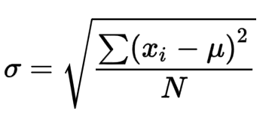
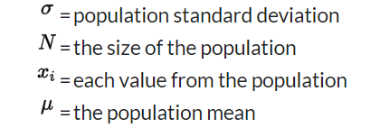
Statistics
Standart Deviation: Standard deviation measures the variation or dispersion of the data points in a dataset. It depicts the closeness of the data point to the mean and is calculated as the square root of the variance.
Population Data V/s Sample Data: Population data refers to the complete data set whereas sample data refers to a part of the population data which is used for analysis. Sampling is done to make analysis easier.

Slide 9
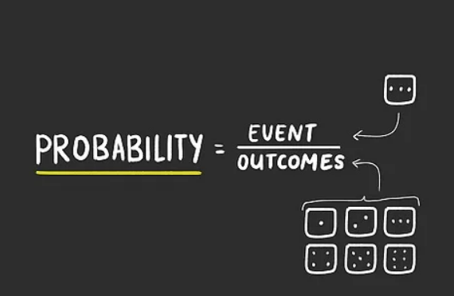
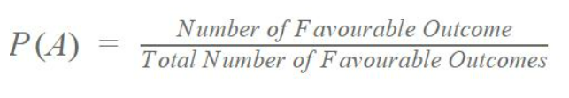
Probability
What is Probability?
It means how likely an event is about to occur or
the chance of the occurrence of an event.
The formula for probability is:
For example: The probability of the coin showing heads when it’s flipped is 0.5.

Slide 10
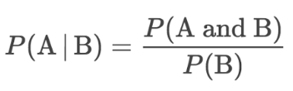
Conditional Probability
Conditional probability is the probability of an event occurring provided another event has already occurred.
The formula of conditional probability is:

Slide 11
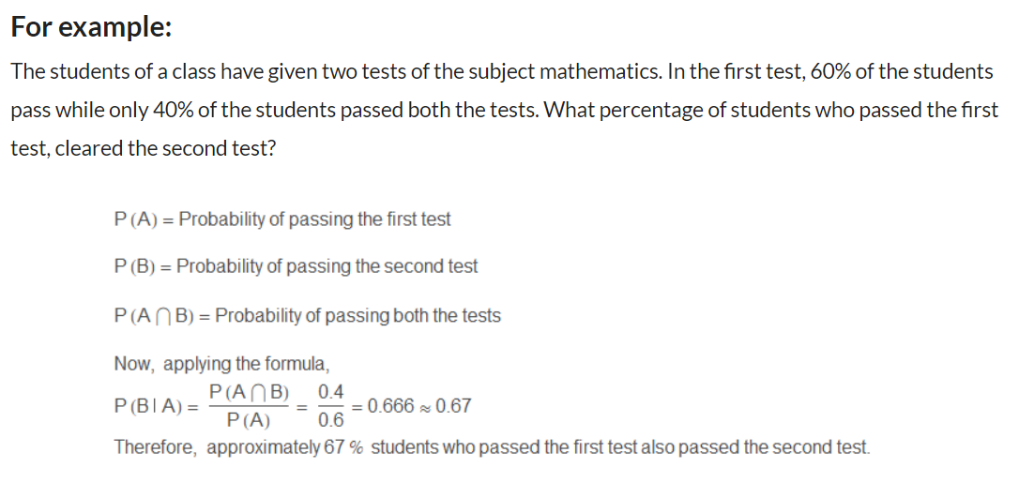

Slide 12
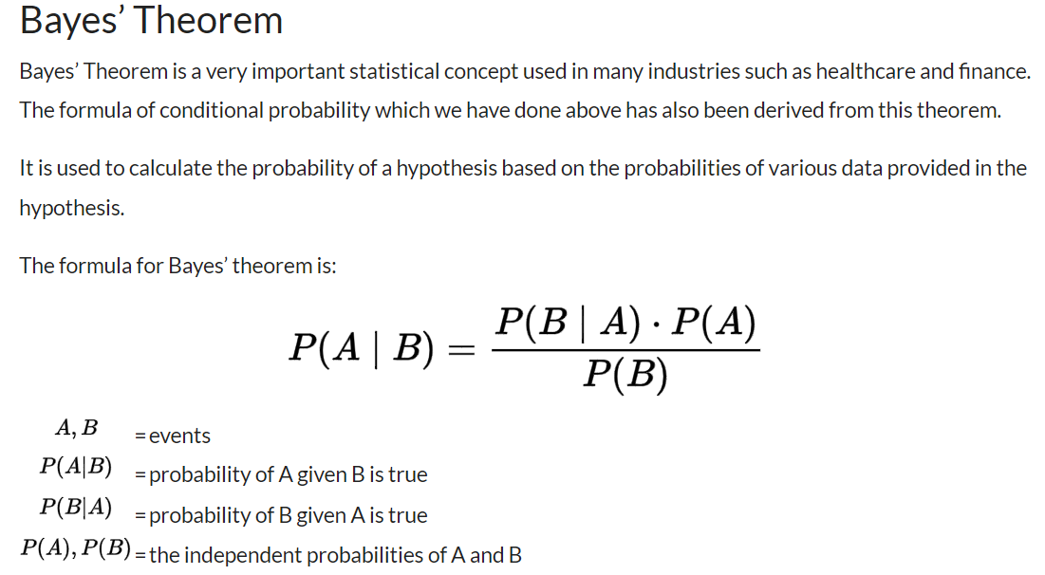

Slide 13
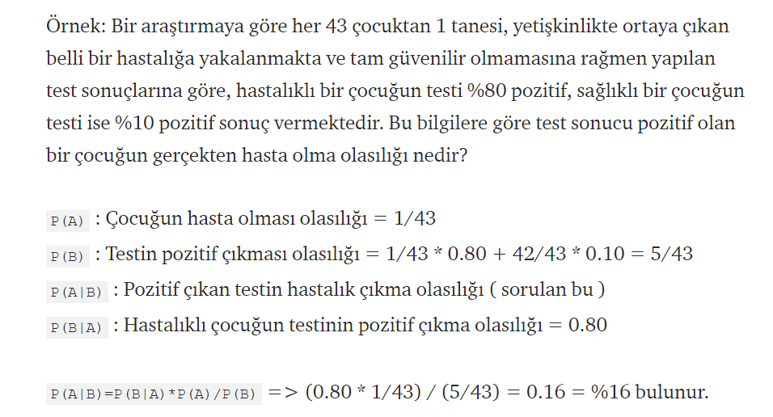

Slide 14
Understanding Probability And Statistics: The Essentials Of Probability For Data Scientists

Slide 15
Understanding Probability And Statistics: The Essentials Of Probability For Data Scientists
(https://towardsdatascience.com/understanding-probability-and-statistics-the-essentials-of-probability-for-data-scientists-459d61a8da44)
Why Start With Probability?
What Is A Probability Space?
What Is A Random Variable?
The Probability Rules
What Is Expectation?
What Are Variance And Covariance?
What Are Probability Distributions?

